Slide 1




TranspoMaster
TranspoMaster
Logistics Management System
Streamlining your logistics with smart, efficient management solutions.
START SLIDE
www.transpomaster.com

Slide 2

Corporate Business
Technologies Used:
React JS
SpringBoot
MySQL
Razor Payment Gateway API
www.reallygreatsite.com

Slide 3
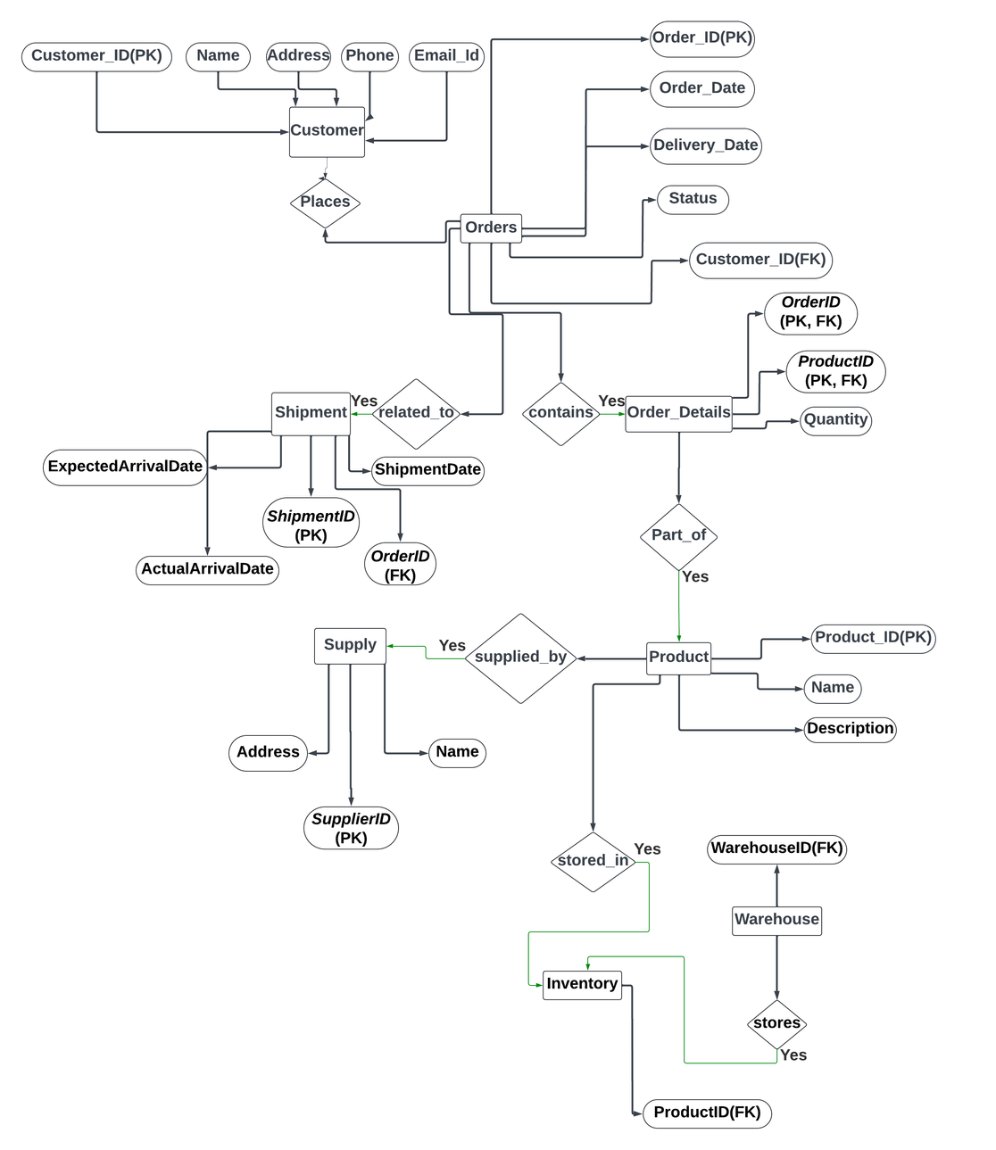
TranspoMaster
ER - DIAGRAM

Slide 4
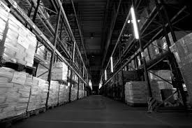
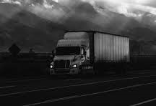
TranspoMaster
Services
Land Transport (Roadways and Railways)
Pipeline Transport
Warehouse Distribution
Inventory Management
Air and Water Transport
LEARN MORE
www.transpomaster.com

Slide 5
TranspoMaster
Inventory Management
Our advanced inventory management system empowers businesses to efficiently track and manage their goods across the entire supply chain. By leveraging real-time data and analytics, it enables precise inventory control, reducing the risk of overstocking or stockouts. Seamless integration with your existing platforms ensures a streamlined workflow, enhancing overall operational efficiency and customer satisfaction.
With real-time updates, automated alerts, and seamless integration with existing systems, you can minimize errors, reduce overhead costs, and ensure that your inventory is always optimized.
Whether it's managing stock levels, handling returns, or forecasting demand, our solution provides the tools you need to keep your operations running smoothly and your customers satisfied.

Slide 6


Shipment Tracking
Our Special Services
Our shipment tracking system offers reliable and up-to-date information on the status of your goods. While real-time tracking is our goal, our current solution ensures that you receive accurate and timely updates as data is fetched from our backend systems. This approach allows you to monitor shipments at key intervals, keeping you informed of crucial stages in the delivery process. With regular status updates, you can maintain visibility over your logistics operations and provide your customers with dependable information on their shipments.

Slide 7
Transportation Solutions: Land, Water, and Air
Key tools for delivering impactful lectures and speeches in logistics.
Establish us as a major player in the logistics industry.
Land Transport
01
Our network ensures fast, secure delivery with optimized routes and reliable vehicles
Water Transport
02
Cost-effective global shipping with trusted carriers for safe, large-volume transport.
Air Transport
03
Fast, reliable delivery with top airlines and secure handling for urgent shipments.

Slide 8


Transpomaster
Admin Dashboard
Analytics and Reports:
Detailed performance reports and custom analytics.
Inventory Management:
Manage inventory levels, stock movements, and reorder alerts.
Order Management:
Track and manage customer orders from placement to delivery.
User Management:
Manage admin and user accounts, permissions, and activity.

Slide 9

Our Team:
JENISHA ANGEL B - 727822TUAD025
PAVITHRA E - 727822TUAD035
RAKESH KUMAR V S - 727822TUAD040
SREELEKA M S - 727822TUAD051

Slide 10

TranspoMaster
Thank You!!
TEAM-7
END SLIDE
www.Transpomaster.com

